Slide 1

DTSC-691
Capstone Database Final Project
2023SU1
By: Matt Dalgetty

Slide 2
Overview
Background
Objectives
Database
Application
Analysis

Slide 3
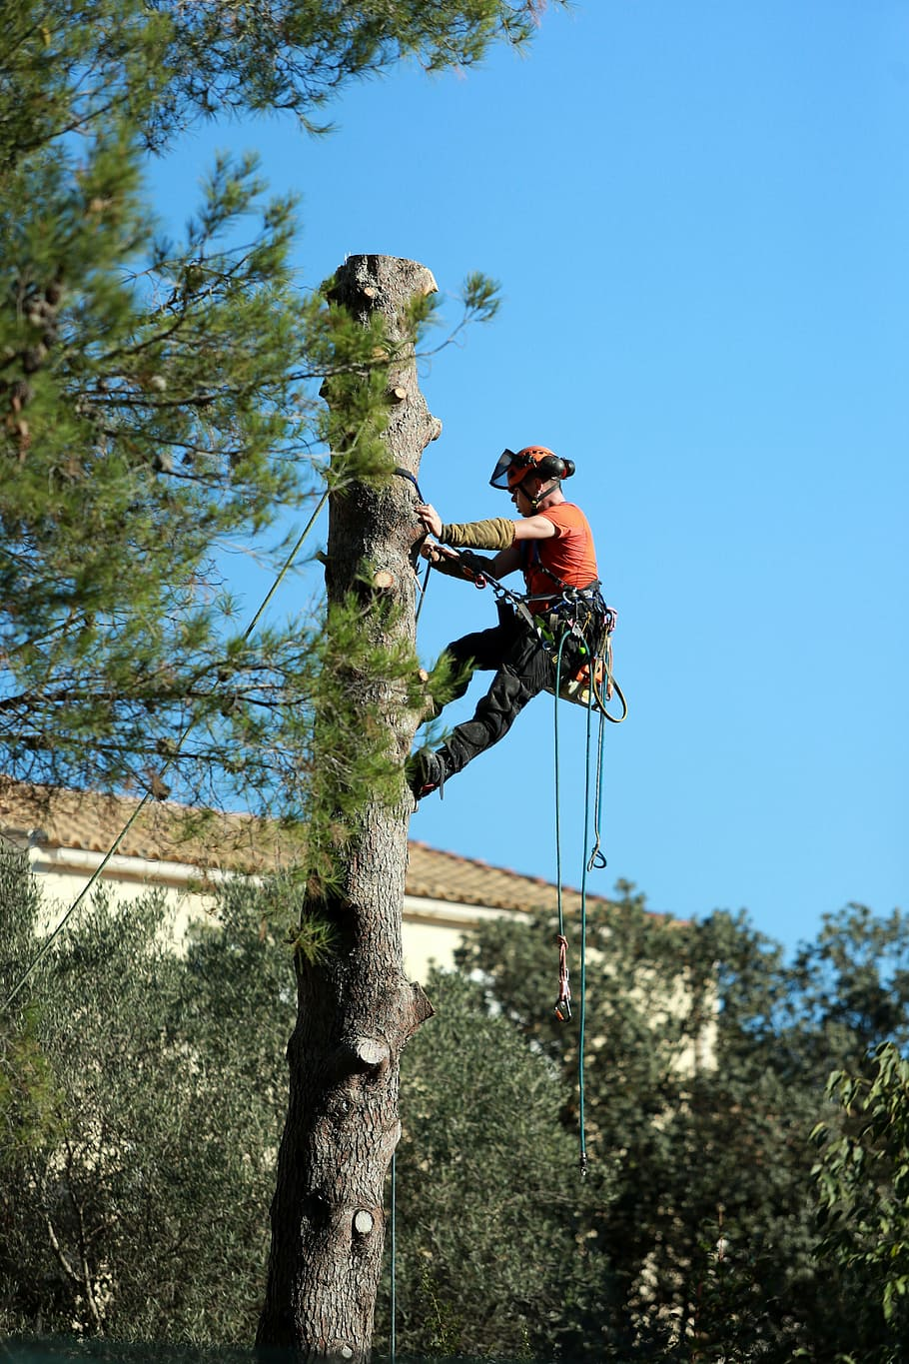
Background
A database for capturing trees worked on in the field by a small tree company

Slide 4
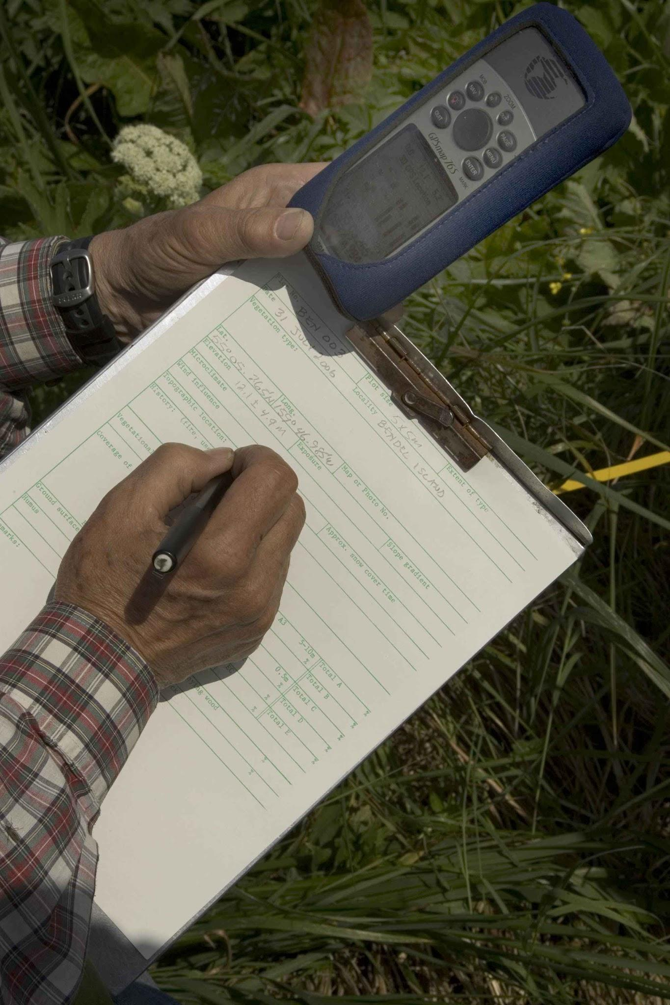
Objectives
Create a relational database and build a webapp to perform Create, Read, Update, & Delete operations

Slide 5
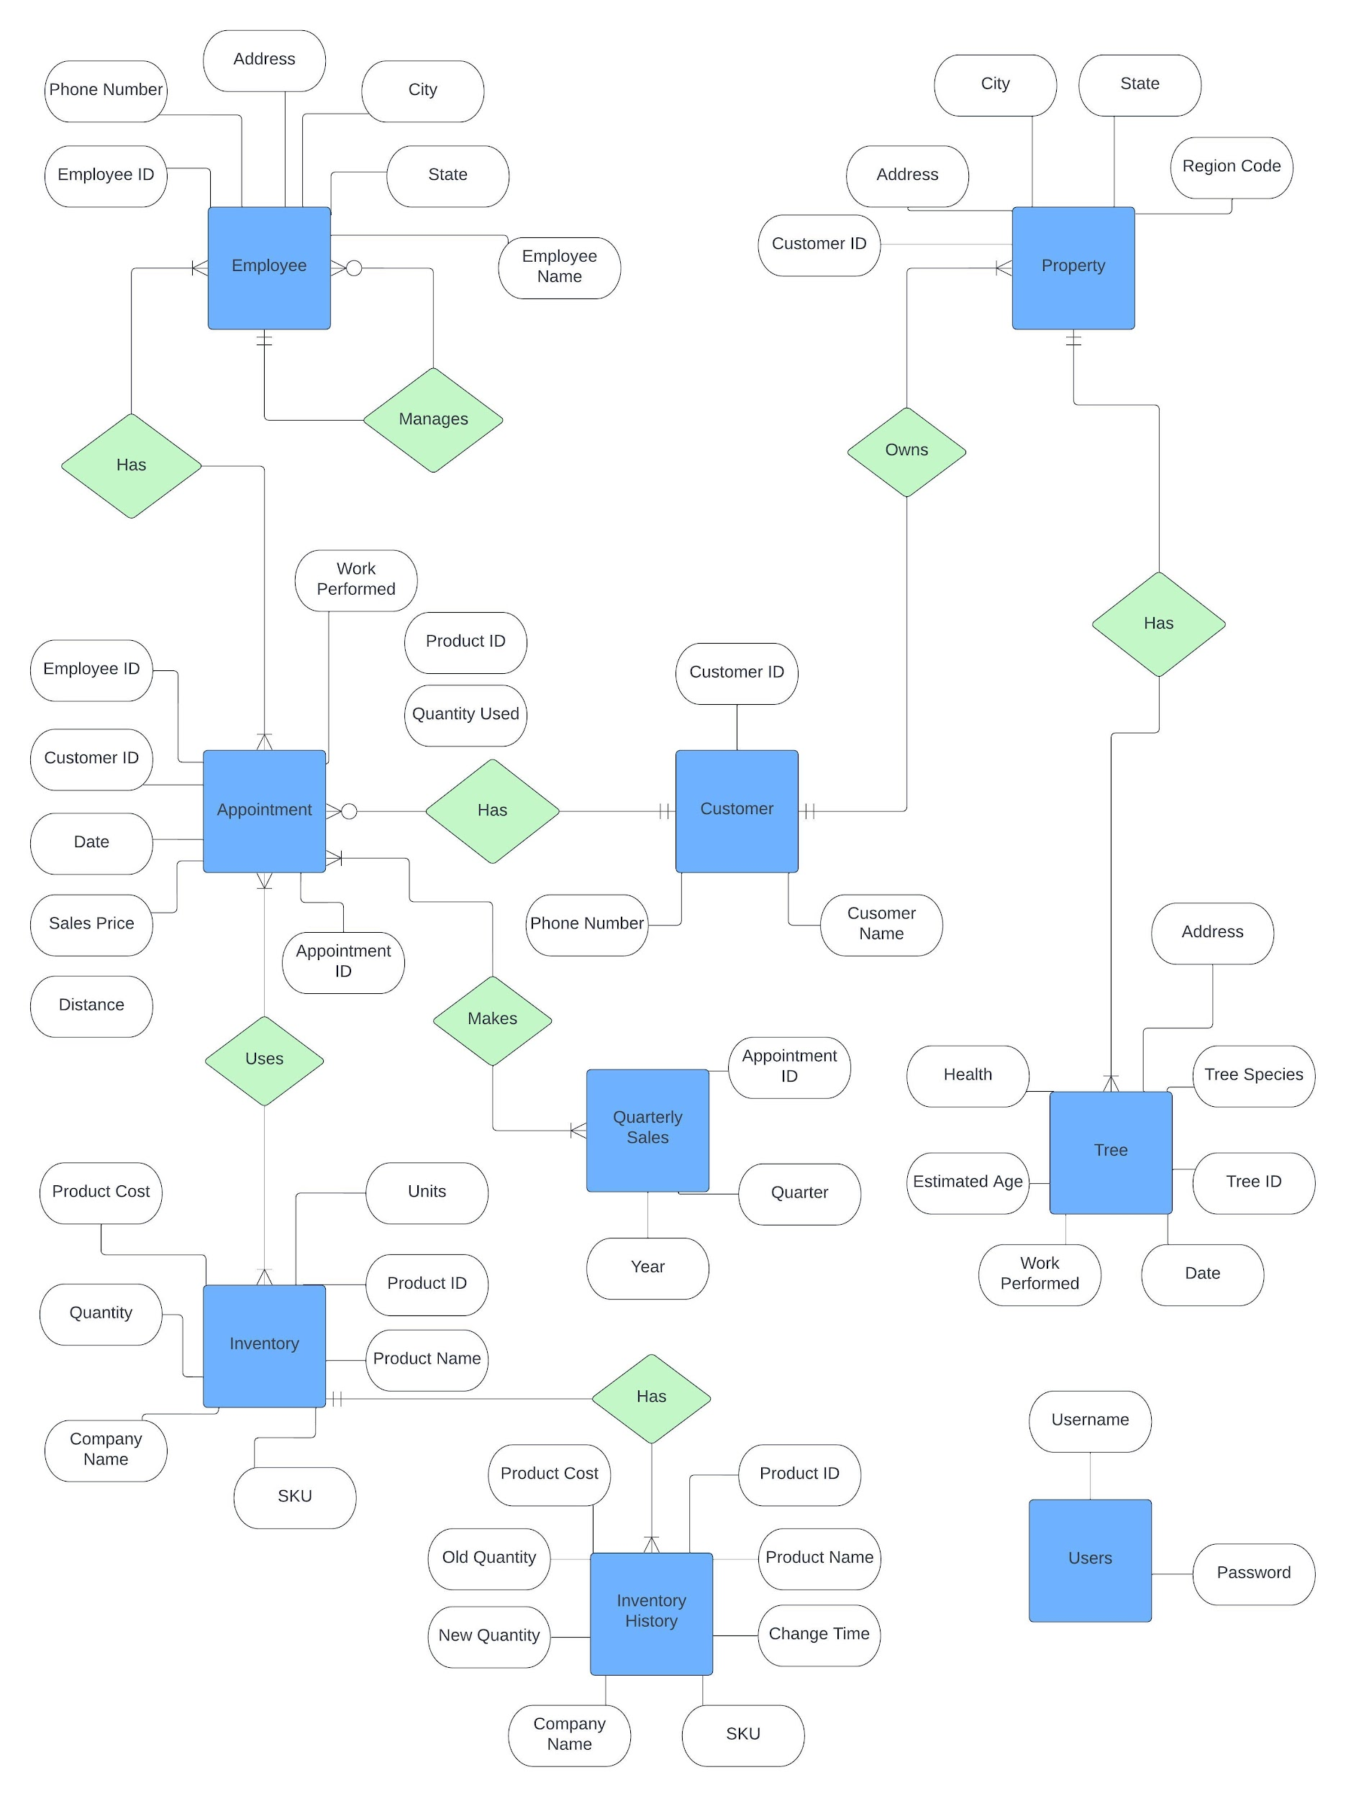
Entity Relationships
8 primary tables in the relational database
1 table to store user login information

Slide 6
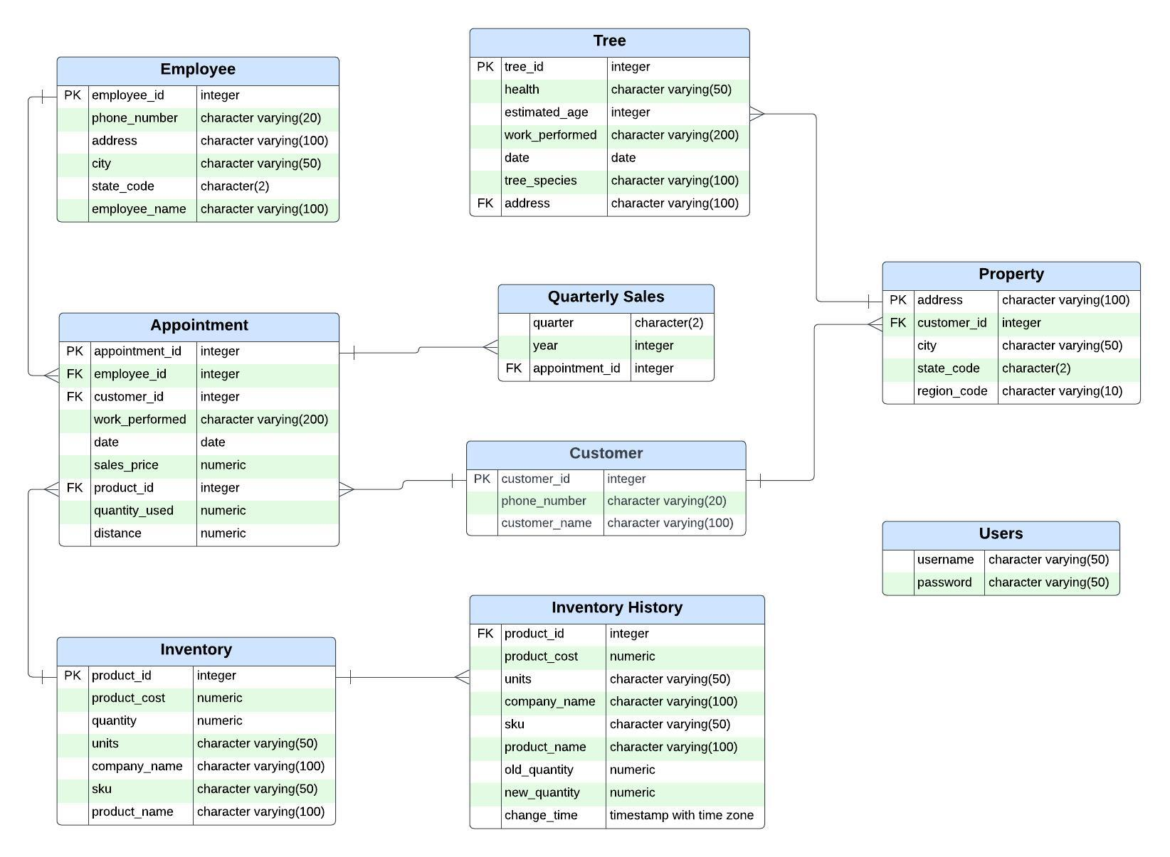
Database Schema

Slide 7
Implementation

Slide 8
Analysis

Slide 9
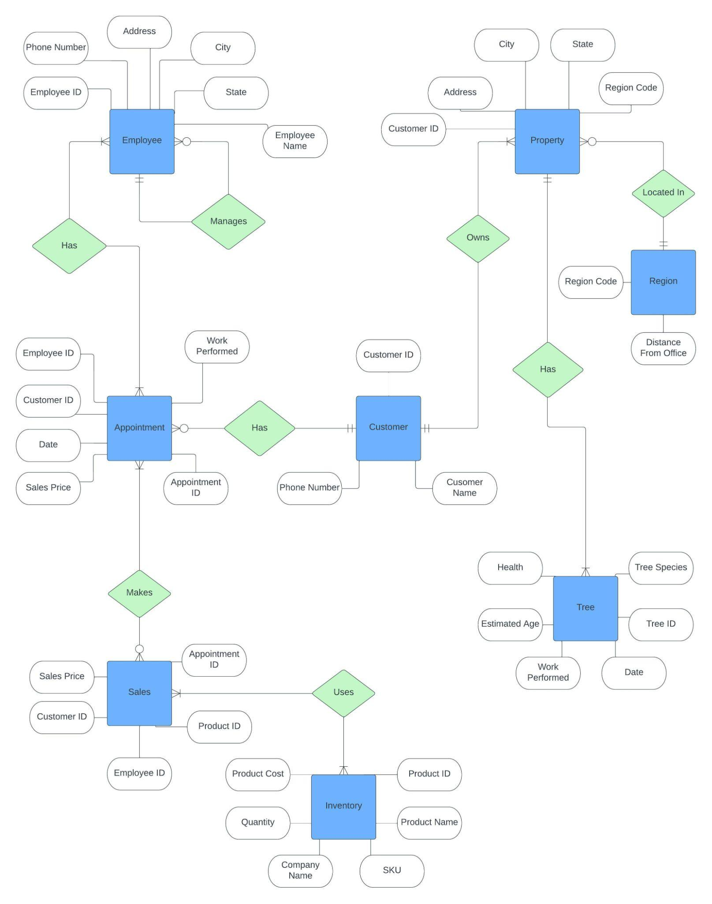

Slide 10
Thank you

